Slide 1
CSC 112: Computer Operating Systems Lecture 25 File Systems
Department of Computer Science,
Hofstra University
Acknowledgement: Lecture slides based on UC Berkeley CS 162: Operating Systems and System Programming

Slide 2
Outline
Files
Directories
File system implementation
Notes:
Some parts of this chapter will be skipped.

Slide 3
File System
Physical reality
Physical sector is unit of storage
Block oriented
No protection among users of the system
Data might be corrupted if machine crashes
File system model
File is a unit of storage
File is a sequence of bytes
Users protected from each other
Robust to machine failures

Slide 4
What is a ‘file’?
A file is
an abstraction to describe stored information.
A logical unit of information created by a process.
A file has (from users point of view)
A name (usually conveys meaning about the contents of the file)
May have an extension to denote the type of contents or associated application (that created or uses the file).
Stored information
A size
Information on ownership

Slide 5
File systems
Files should be
Persistent
Exists regardless of if processes are using it
Shareable between processes
Have a consistent and clearly defined structure (how they are stored)
This is important to the OS that manages the files

Slide 6
File naming
Naming rules are dependent on the OS.
Naming rules specify
Characters legal within the name
Maximum / minimum number of characters
Whether name is case sensitive
Structure of name (are there extensions, etc.)
Are file names fixed length or variable length
…

Slide 7
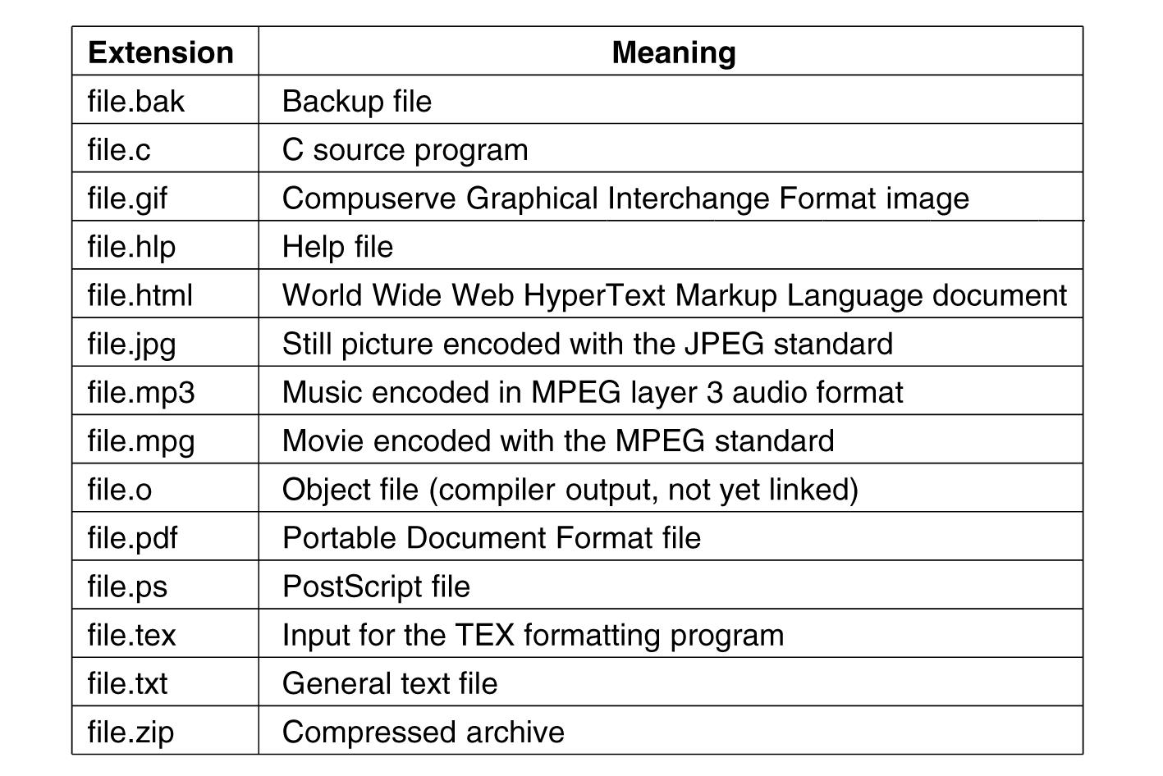
Some typical file name extensions

Slide 8
File Structure
An unstructured sequence of bytes
Most widely used, e.g., UNIX and Windows
User programs impose meaning of files
A sequence of fixed-length records
Records have internal structure
Read/write in records
Not used in any current general-purpose system
A tree of records
Search records by keys
Used on some large mainframe computers

Slide 9
Examples of File Structures
1 byte
1 record
Name: Jack SIN Address Account #
Name: Carole SIN Address Account #
Name: Nicola SIN Address Account #
Name: Andrew SIN Address Account #
Ant | Fox | Pig
Cat | Cow | Dog
Goat | Lion | Owl
Hen | Ibis | Lamb
Tree
Byte sequence
Record sequence

Slide 10
File types
Regular files – store user’s information
ASCII files (text file): lines of text
Can be displayed and printed as is.
E.g., source code file (*.cpp, *.h)
Binary files: binary streams
Internal structure know to programs
e.g., Object file, executable code (*.o, *.exe).
Directories – maintained by system
Maintaining the structure of the file system
UNIX special files: modeling I/O devices
Character special files: serial I/O devices
Block special files: disks/block devices
Notes:
May have internal structure inside the list of bytes making up the file. Special files: character files to model serial I/O devices, block files to manage disks
Mainly two types of files
Regular files that contain user information in either ASCII or binary formats.
All files in previous slide are regular files
Directories used by the system to manage and maintain the file structure
Called “folders” on Windows

Slide 11
File Access
Sequential access
Read all the bytes in order from the beginning
Rewind if read again
Random access files
Read the bytes/records by specifying positions
Applications: database, etc.
All the files are random access nowadays
How to specify the starting point for reading
Use seek operation to set the current position
Roll forward/backward for n bytes

Slide 12
File Attributes
Attribute | Meaning
Protection | Who can access the file and in what way
Password | Password needed to access the file
Creator | ID of the person who created the file
Owner | Current owner
Read-only flag | Read/write or read only
Hidden flag | Normal file or the file does not display in listings
System flag | Normal file or system file
Archive flag | The file has been backed up or not
Random access flag | Sequential access only or random access
ASCII/binary flag | ASCII file or binary file
Temporary flag | Normal file or file will be deleted on process exit
Lock flags | Unlocked or locked
Record length | Number of bytes in a record
Key position | Offset of the key within each record
Key length | Number of bytes in the key field
Creation time | Data and time the file was created
Time of last access | Date and time the file was last accessed
Time of last change | Date and time the file was last changed
Current size | Number of bytes in the file
Maximum size | Number of bytes the file may grow to
File protection and access
Flags control/enable some specific property
Used in file with records having a key
Time stamps
Size

Slide 13
Operations on files
The most common system calls relating to files:
Create
Delete
Open
Close
Read
Write
Append
Seek
Get Attributes
Set Attributes
Rename

Slide 14
Directory
A collection of files and/or other directories
Also called “folder” on Windows machines.

Slide 15
Organization: Single-level / Two-level
Single-level: one directory for all the files
Not good for huge amount of files
Not good for multi-user system
Two-level: user→directory
A large number of files from one user, inconvenient
root
root
User A
User B
User A:
File mymails
User B:
File mymails
File mymails
File mymails

Slide 16
Hierarchical Directory Systems
A general hierarchy: a tree of directories
User directory
root
directory
directory
directory
file
file
directory
file
directory
directory
file
file
file
file

Slide 17
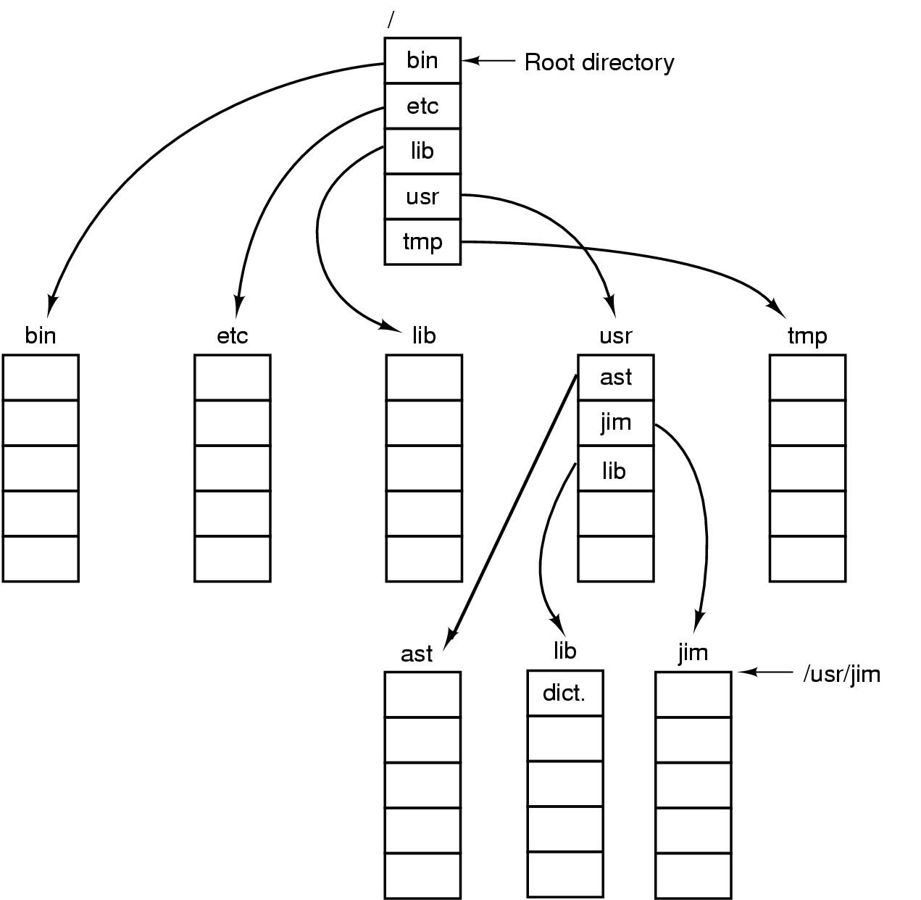
A UNIX directory tree.

Slide 18
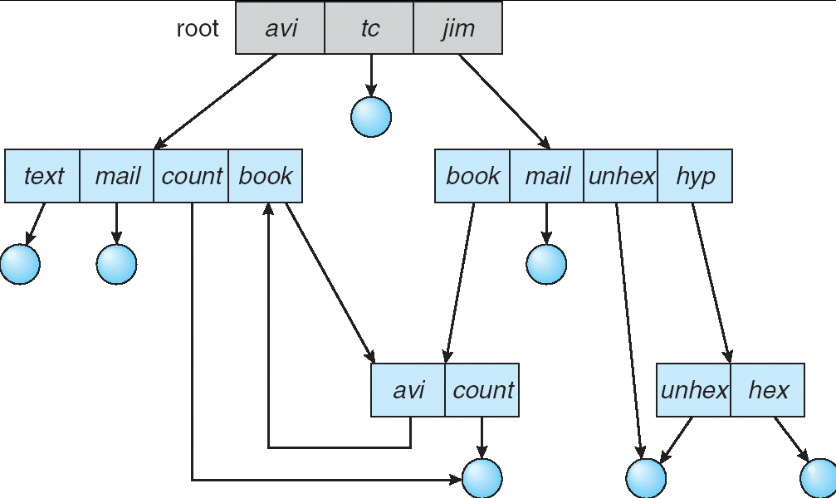
Directory Structure
Not really a hierarchy!
Many systems allow directory structure to be organized as an acyclic graph or even a (potentially) cyclic graph
Hard Links: different names for the same file
Multiple directory entries point at the same file
‘ln’ command in UNIX
Soft (symbolic) Links: “shortcut” pointers to other files
Implemented by storing the logical name of actual file
‘ln –s’ command in UNIX
Name Resolution: The process of converting a logical name into a physical resource (like a file)
Traverse succession of directories until reach target file
Notes:
Global file system: May be spread across the network

Slide 19
Path Names
Mechanism to locate files
Absolute path name
Path starting from the root directory
E.g., /usr/fran/mailbox. ‘/’ is path separator (‘\” on Windows)
Relative path name
Relative to the current working directory
E.g., if working directory is /usr/fran, then /usr/fran/mailbox = mailbox
Each process has its own working directory
Current directory “.” and parent directory “..”
E.g., ../cindy/mailbox, ./mailbox

Slide 20
Directory Operations (UNIX)
Create: a directory is created
Empty except ‘.’ and “..” entries
Delete, rename a directory
Link (hard link)
Allow a file to appear in more than one directory
One copy of a file, multiple directory entries
Unlink
A directory entry is removed
Link count == 0
Yes: remove the file (free the i-node and data blocks)
No: keep the file

Slide 21
File Management System
System software to provide I/O services to users
Meet needs of user, access and organize files and directories, providing standardized interface
Each user can create, modify, delete their own files and directories and have controlled access to files of other users
Each user may control access by others to their files
Each user should be able to organize their files for efficient use, and refer to them by symbolic names
Verify validity of files, minimize lost/damaged data
Optimize throughput and system usage for I/O to files
Provide support for a variety of devices

Slide 22
File System Components
Disk management
Arrange collection of disk blocks into files
Naming
To locate file data, user provides to file system file name, not track or sector number
Access Security
Keep information secure, don’t leak, don’t allow someone else to modify file
Reliability/durability
When system crashes, may lose data in main memory (volatile), but want files to be durable
User
File
Naming
File
Access
Disk
Management
Disk
driver

Slide 23
File Descriptor
File descriptor (fd)
The user process side
Before reading or writing a file, user process has to call open(filename, mode): mode is either r, rw, w, …
open(…) checks if access is valid (Unix has fopen(…))
fd=open(…) returns a unique integer called the file descriptor
User process needs to use fd for all future operations on that file read(fd, buff) or write(fd, buff)
When user process done with that file, it calls close(fd)
The file system side
File system maintains an internal data structure for each open file, i.e., for each valid file descriptor. Created on open(…), deleted on close(…).
Open file table : system-wide list of file descriptors in use

Slide 24
Reading A Block
PCB
read( fd, userBuf, size )
PCB: Process Control Block
Open
file
table
Get physical block to sysBuf
copy to userBuf
Metadata
read( device, phyBlock, size )
Buffer
cache
Logical → physical
Disk device driver

Slide 25
File System Layout
Disk is divided up into several partitions
Each partition has one file system
MBR – master boot record
Boot the computer & contain the partition table
Partition table
Starting & ending addresses of each partition
One partition is marked as active
Within each partition
Boot block – first block, a program loads the OS
Superblock – key parameters about the file sys.
MBR | Partition 1 | Partition 2 | Partition 3 | Partition 4
Boot block | Super block | Free space mgmt | I-nodes | Root dir | Files and directories

Slide 26
Implementing Files
Key issue: how to keep track of which disk sectors go with which file?
E.g., block size= 512B, file size=2014B, so where are these 2014/514=4 blocks on disk?
Many methods
Contiguous allocation
Linked list allocation
I-nodes
Each one has its own pros and cons

Slide 27
File systems Implementation Challenges
Files grow and shrink in pieces
Little a priori knowledge of this dynamism
Several orders of magnitude in file sizes – smallest files are 0B large, largest are a few GB’s-TeraBytes’s (that’s 1024 GB’s)
Need to overcome/hide/mask disk performance behavior
Desire for efficiency
Coping with failure (of devices, or by users)

Slide 28
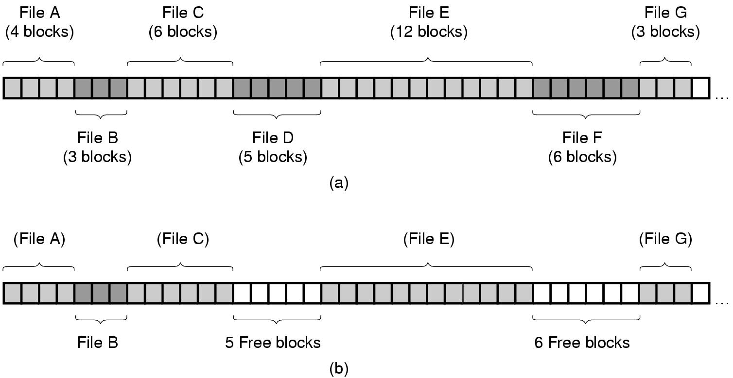
Contiguous Allocation
Figure 4-10. (a) Contiguous allocation of disk space for 7 files.
(b) The state of the disk after files D and F have been removed.

Slide 29
Internal vs. External Fragmentation
Internal fragmentation: space wasted at the end of each block
External fragmentation: Free blocks are scattered throughout the disk, instead of forming a few large contiguous sets of free blocks
Block 1
Block 2
Block 3
Block 4
Block 5
Block 6
File 1
File 2
File 3
Notes:
A block will contain the records or bytes that form part or all of a file
Placing the start of a file 2 after the end of a file 1 in the same block makes increasing file size of the file 1 very difficult. It also means that increasing the size of file 1 requires manipulation of file 2

Slide 30
Enlarging a File
What happens if file2 in Block3 grows by two blocks?
Cannot allocate next contiguous block (block 4) because it is already in use
To assure the file is contiguous
Find a large enough series of empty blocks to hold the extended file
Copy existing portion to this series of block, then append the new blocks (copy block 3 to block 1, then append new blocks, block 3 is now available)
Block 0
Block 1
Block 2
Block 3
Block 4
Block 5
Block 6
Block 7
Block 8
Block 9
Block 10
File 1
File 3
File 2

Slide 31
Contiguous Allocation Pros and Cons
Pros
Simple to implement
Each file has two numbers, starting address & length
Read performance is excellent
Cons
Expensive to grow a file if relocation is necessary
Deletion of files may cause external fragmentation
Notes:
available blocks to be fragmented or distributed throughout the disk (external fragmentation) with few or no large blocks of blocks availableMust leave space at the end of each file and/or move as shown in previous slide
File can be located using a single pointer to its first block
Need only pointer and number of blocks to retrieve entire file

Slide 32
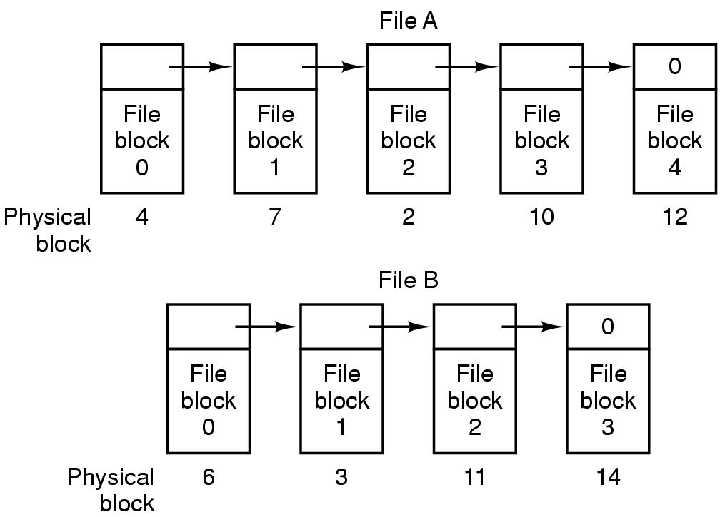
Linked-List Allocation
File A uses disk blocks 4, 7, 2, 10, and 12, in that order
File B uses disk blocks 6, 3, 11, and 14, in that order.
Figure 4-11. Storing a file as a linked list of disk blocks.

Slide 33
Linked List Allocation Pros and Cons
Pros
No space is lost due to disk fragmentation (except for internal fragmentation in the last block)
Makes expansion/contraction of file simple
File is still referenced by a single pointer to its first block
Sequential access of file is efficient
Just follow the pointers!
Cons:
Random access of file not efficient
Must chase pointers from the first block
The pointer takes up a few bytes, so data blocks no longer 2^{N} long
Less efficient for many programs that expect 2^{N} block sizes
Notes:
Allows fragmentation of files on the disk which can become significant over time

Slide 34
File Allocation Table (FAT)
Same example as before:
File A uses disk blocks 4, 7, 2, 10, and 12, in that order
File B uses disk blocks 6, 3, 11, and 14, in that order.
Used by MS/DOS and early Windows
Figure 4-12. Linked list allocation using a file allocation table in main memory.

Slide 35
FAT Pros and Cons
Pros:
No pointers in data blocks → data blocks are 2^{N} long
Random access is easy, since pointer-chasing is done on the table, no need to access disk blocks
Cons:
Entire table must be kept in memory; can get large
With a 200-GB disk and a 1-KB block size, the table needs 200 million entries. Each entry has to be a minimum of 3 bytes. Thus the table will take up 600 MB of main memory

Slide 36
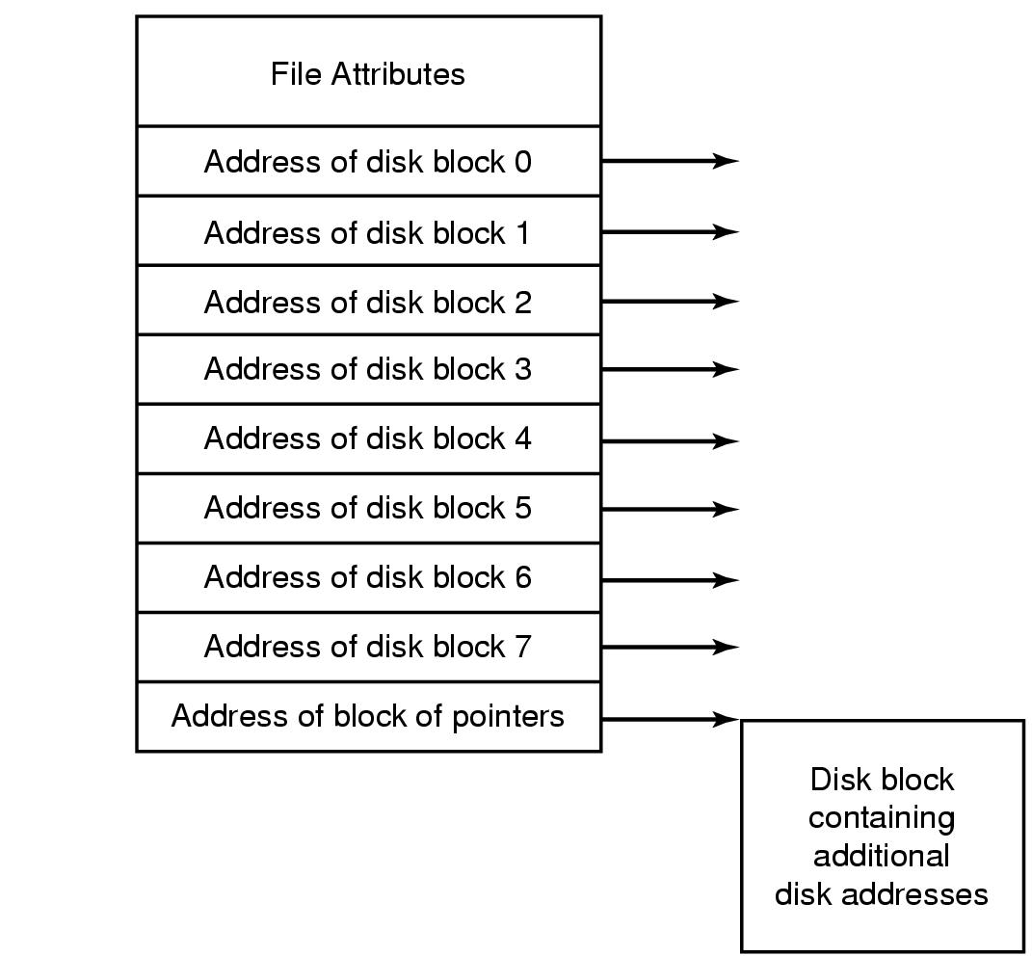
I-nodes
I-node (index-node) lists disk addresses of the file’s blocks
Used in UNIX

Slide 37
Implementing Directories
Directory system: map the ASCII file name onto the info needed to locate the data
Directory entry
Where are the attributes stored?
In the directory entry (MS-DOS/Windows)
In the i-nodes (UNIX)
i-node
Games | Attributes
Mail | Attributes
News | Attributes
Work | Attributes
Games
Mail
News
Work
File attributes
Address of disk block 0
Address of disk block 1
…
DOS/Windows
UNIX

Slide 38
Locate A File: /usr/ast/mbox
Block 406 is /usr/ast dir.
root
1 | .
1 | ..
4 | bin
7 | dev
14 | lib
9 | etc
6 | usr
8 | tmp
I-node 6 is for /usr
Block 132 is /usr dir.
I-node 26 is for /usr/ast
26 | .
6 | ..
64 | grants
92 | books
60 | mbox
81 | simix
17 | src
6 | .
1 | ..
19 | dick
30 | erik
51 | jim
26 | ast
45 | bal
Attr.
406
…..
Attr.
132
…..
/usr is in block 132
/usr/ast is in block 406
/usr/ast/mbox is i-node 60
Looking up usr yields i-node 6
/usr/ast is i-node 26
Notes:
How many disk accesses to resolve “/my/book/count”?
Read in file header for root (fixed spot on disk)
Read in first data bock for root
Table of file name/index pairs. Search linearly – ok since directories typically very small
Read in file header for “my”
Read in first data block for “my”; search for “book”
Read in file header for “book”
Read in first data block for “book”; search for “count”
Read in file header for “count”
Current working directory: Per-address-space pointer to a directory (inode) used for resolving file names
Allows user to specify relative filename instead of absolute path (say CWD=“/my/book” can resolve “count”)

Slide 39
Sequence of disk accesses to resolve “/usr/ast/mbox”?
Read in inode for root (fixed position on disk)
Read in first data bock for root; search for “usr” to get address of its inode.
Table of file name/index pairs. Search linearly – ok since directories typically very small
Read in inode for “usr” to get addresses of its data blocks
Read in first data block for “usr”; search for “ast” to get address of its inode.
Read in inode for “ast” to get addresses of its data blocks
Read in first data block for “ast”; search for “mbox” to get address of its inode.
Read in inode for “mbox” to get addresses of its data blocks
Current working directory: Per-address-space pointer to a directory (inode) used for resolving file names
Allows user to specify relative filename instead of absolute path (if CWD=““/usr/ast/”, then can resolve “mbox” without absolute path.)

Slide 40
I-nodes Pros and Cons
Pros:
Small size: an i-node need only be in memory when the corresponding file is open, hence total size of i-nodes is proportional to max number of files that are open simultaneously
In contrast, FAT table size is proportional to total number of disk blocks
Cons:
Each i-node has a fixed number of disk addresses; a file may grow beyond the limit
Solution: reserve the last disk address for the address of a block containing additional disk block addresses (indirect blocks)
Notes:
Indexed Nodes or I-Nodes are used in Unix/Linux systems
Need to keep the I-node structure for open files in memory (not all I-node structures for all files stored on the disk)
Each I-node used 64 bytes, with possible extra storage needed for the address array blocks (for large files)
The memory needed does not increase as the size of the disk increases (as it does for a FAT)

Slide 41
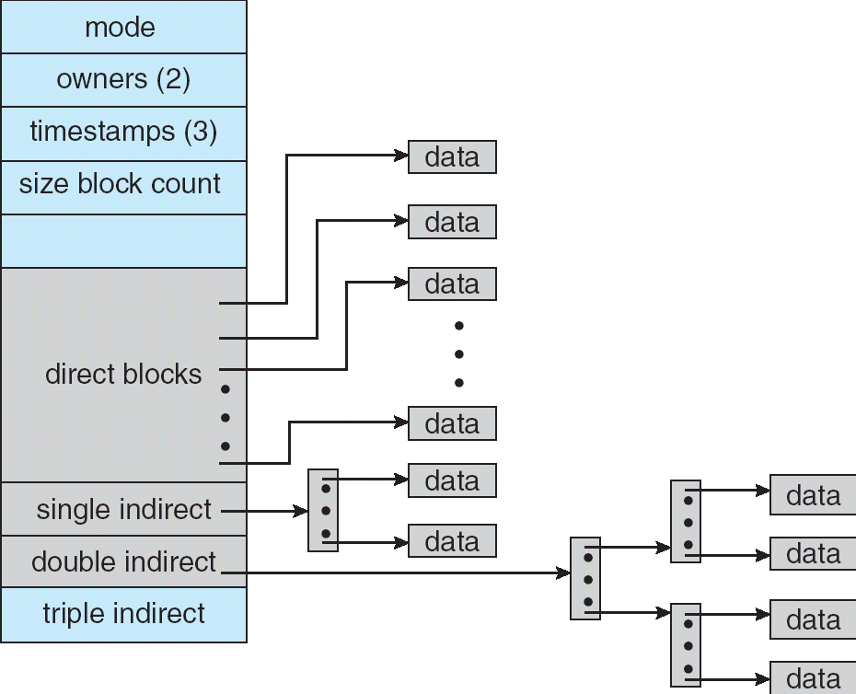
Multilevel Indexed Files
Multilevel Indexed Files: Like multilevel page tables
(from UNIX 4.1 BSD)
Key idea: efficient for small files, but still allow big files
I-node (File header) contains 13 pointers
Fixed size table, pointers not all equivalent
File Header format:
First 10 pointers are to data blocks
Pointer 11 points to “indirect block” containing 256 block ptrs
Pointer 12 points to “doubly indirect block” containing 256 indirect block ptrs for total of 64K blocks
Pointer 13 points to a triply indirect block (16M blocks)

Slide 42
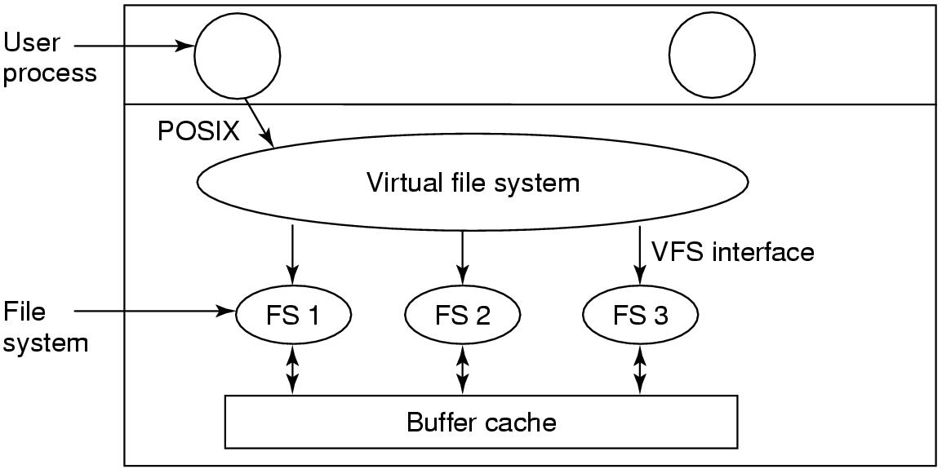
Virtual File System
An additional layer of software to hide differences among different file systems and present a uniform interface (e.g., POSIX) to the user

Slide 43
Approaches: Summary
Contiguous storage:
Excellent access time (sequential and random)
Poor space usage with external fragmentation
Simple management, no need for data structures to relate non contiguous blocks
VERY difficult and inefficient to extend existing files !!!!
FAT
Good sequential access (2 dereferences per block)
Good random access (order N)
Good space usage with some internal fragmentation
One pointer per block must be stored in memory and on disk, size increases as size of disk increases
Not efficiently scalable to large disks
I-nodes
Good sequential access (2-4 dereferences per block)
Better random access (order logN)
Good space usage with some internal fragmentation
One pointer and one I-node per file on disk
One pointer and one I-node per OPEN file in memory

Slide 44
Choosing a block size
Large block size means
Large amount of internal fragmentation, decreased disk space utilization (less of the disk actually being used)
Wasted space!
Small block size means
Most files occupy multiple blocks, thus need multiple seeks and rotational delays to access
Reduced performance!
Notes:
Continuity of blocks in file (more efficient access and increased data rate)
Smaller table or list describing free blocks
Large block size
1 file no matter how small occupies 1 block
Small files waste a lot of space
Some systems compensate by dividing a large block and placing partially full blocks from multiple files in that block
Small block size
Files span many blocks, more overhead
More seek time, rotational delay
Base choice on observed file size distribution and disk properties
Small files more efficient disk usage
Large file more efficient disk access
s

Slide 45
Free list
Need to keep track of which blocks are free.
Two common approaches
Linked list of disk blocks holding addresses of free blocks
Bitmap, 1 bit for each block, 0 if not allocated, 1 if allocated.
The list or bitmap is kept on the disk (not in memory) to prevent data loss upon system crash

Slide 46
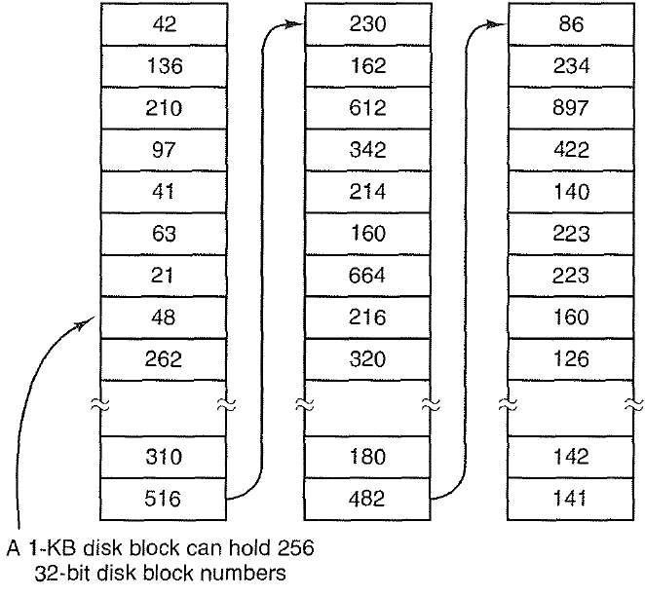
Free list management: linked list
Addresses of free blocks are kept in a list of disk blocks
Suppose each disk block address is 32-bits (4 Bytes), then each 1KB-disk block holds 255 addresses for free blocks (plus one address for the next block)
Figure 4-22. (a) Storing the free list on a linked list

Slide 47
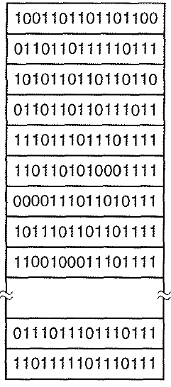
Free list management: bitmap
A disk with n blocks requires a bitmap with n bits.
Each bit in the bitmap refers to a block
1 indicates free blocks
0 indicates allocated blocks
1-bit per block, on contrast to 32-bits per block for the linked list

Slide 48
Free list management: bitmap cont’
How much space is required?
One bit for each block on the disk
Disk size in bytes / (8 * block size in bytes)
Dividing by 8 is for converting from # bits to # bytes
Example for an 8GB disk with 2KB blocks
8*2³⁰/(8*2*2¹⁰)=0.5*2²⁰=0.5 MB (250 disk blocks)
Less space
But more time searching
Used by MacOS, NTFS(Windows)
Q: When will linked-list scheme require less space than bitmap scheme?
A: When the disk is nearly full (with few free blocks)

Slide 49
File System Caching
Key Idea: Exploit locality by caching data in memory
Name translations: Mapping from paths→inodes
Disk blocks: Mapping from block address→disk content
Buffer Cache: Memory used to cache kernel resources, including disk blocks and name translations
Can contain “dirty” blocks (blocks yet on disk)
Replacement policy? LRU
Can afford overhead of timestamps for each disk block
Advantages:
Works very well for name translation
Works well in general as long as memory is big enough to accommodate a host’s working set of files.
Disadvantages:
Fails when some application scans through file system, thereby flushing the cache with data used only once
Example: find . –exec grep foo{}
Other Replacement Policies?
Some systems allow applications to request other policies
Example, ‘Use Once’:
File system can discard blocks as soon as they are used

Slide 50
File System Caching (con’t)
Cache Size: How much memory should the OS allocate to the buffer cache vs virtual memory?
Too much memory to the file system cache ⇒ won’t be able to run many applications at once
Too little memory to file system cache ⇒ many applications may run slowly (disk caching not effective)
Solution: adjust boundary dynamically so that the disk access rates for paging and file access are balanced
Read Ahead Prefetching: fetch sequential blocks early
Key Idea: exploit fact that most common file access is sequential by prefetching subsequent disk blocks ahead of current read request (if they are not already in memory)
Elevator algorithm can efficiently interleave groups of prefetches from concurrent applications
How much to prefetch?
Too many imposes delays on requests by other applications
Too few causes many seeks (and rotational delays) among concurrent file requests

Slide 51
File System Caching (con’t)
Delayed Writes: Writes to files not immediately sent out to disk (similar to write-back cache)
Instead, write() copies data from user space buffer to kernel buffer (in cache)
Enabled by presence of buffer cache: can leave written file blocks in cache for a while
If some other application tries to read data before written to disk, file system will read from cache
Flushed to disk periodically (e.g. in UNIX, every 30 sec)
Advantages:
Disk scheduler can efficiently order lots of requests
Some files need never get written to disk! (e..g temporary scratch files written /tmp often don’t exist for 30 sec)
Disadvantages
What if system crashes before file has been written out?
Worse yet, what if system crashes before a directory file has been written out? (lose pointer to inode!)

